Slide 1
Logo

Slide 2

Logo

Slide 3
Value Proposition

Slide 4
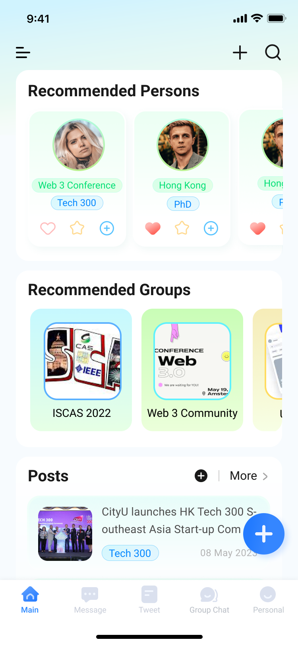
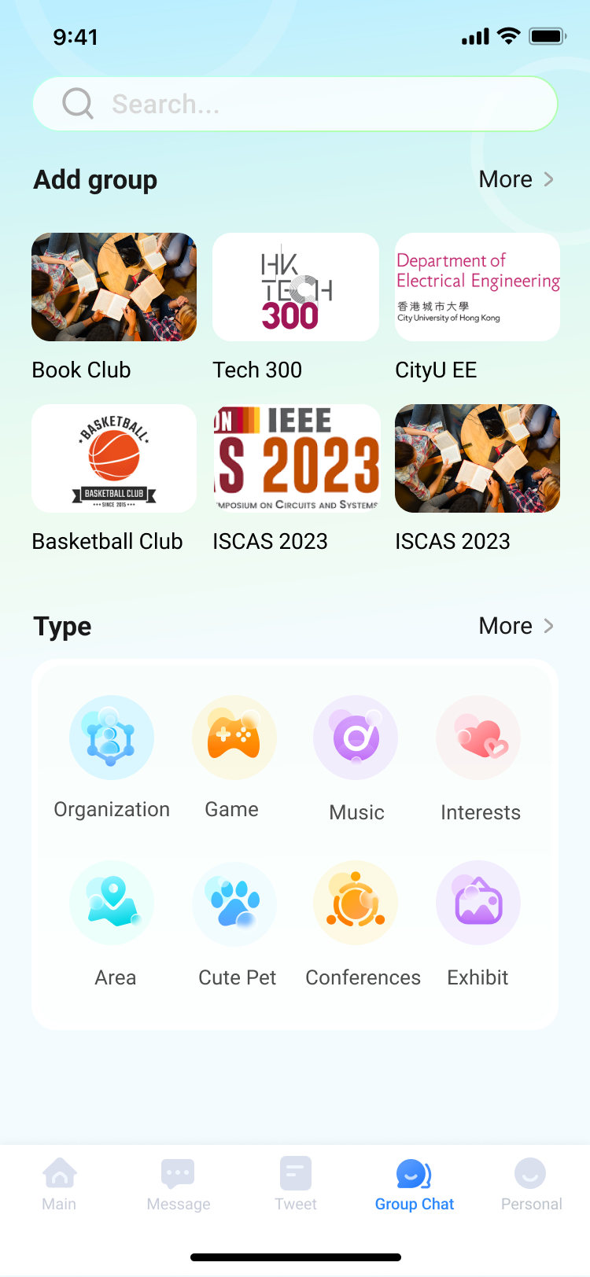
Mission Statement
"Connect with your world through community power: Build, Organize, Provide!"
Recognize your real-world connections by groups
Power community building
Organize community events
Provide public spaces
Boost the communications of communities

Slide 5
Advanced community management

Slide 6
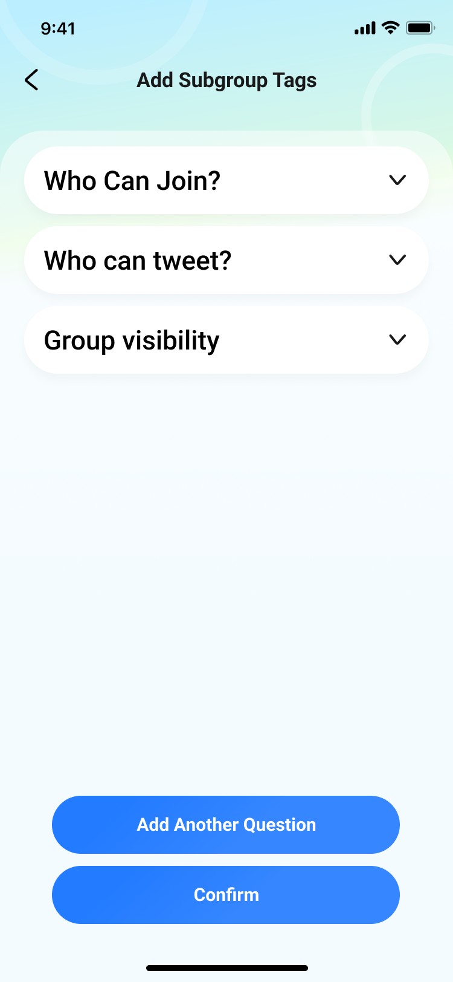
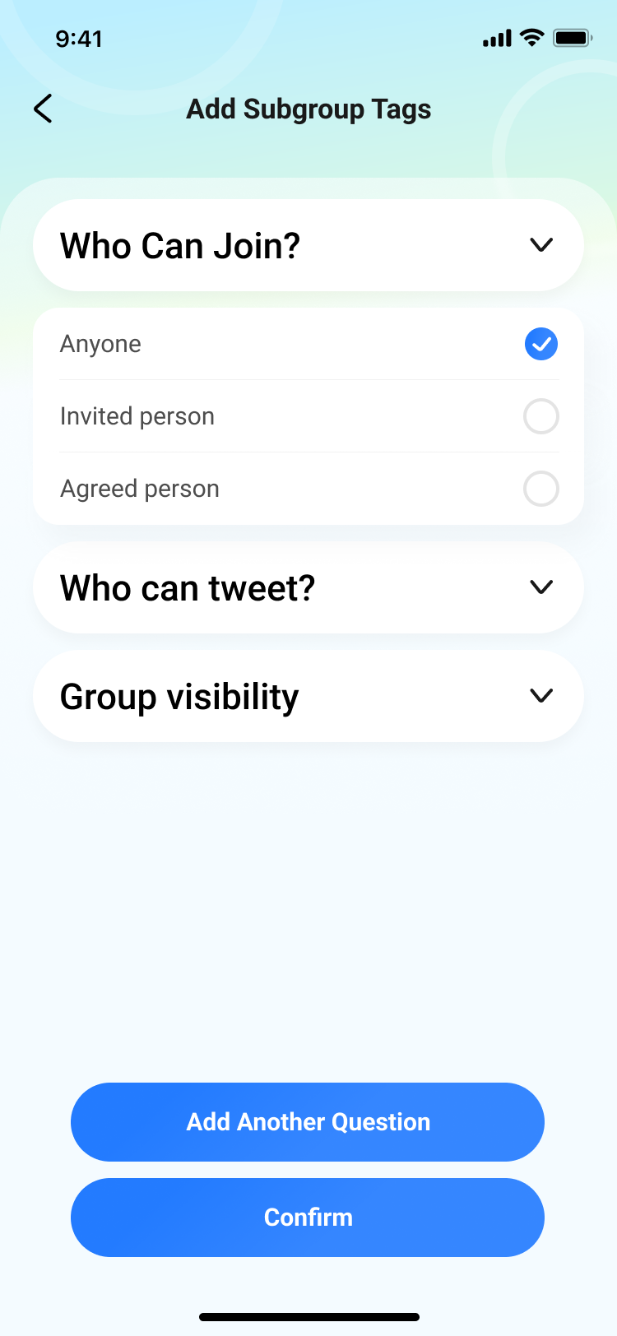
Advanced community management
Create your community with specifications
When creating a new community, you can specify the name, description, and purpose of the community. You can also set the group's visibility, whether it's public or private, and decide who can join the group. You can also set criteria for membership, such as age, gender, location, interests, or any other relevant factors.

Slide 7
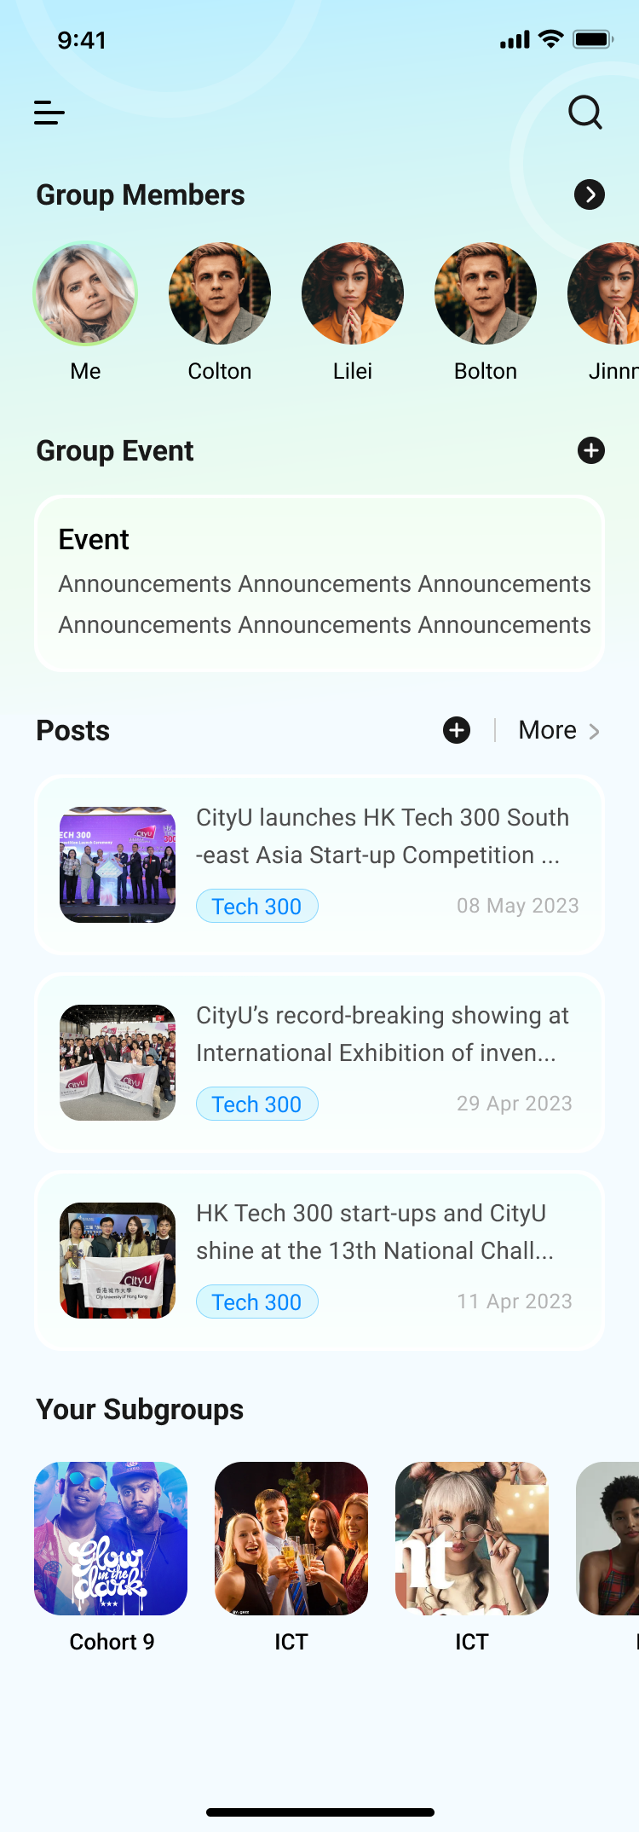
Advanced community management
Provide public spaces for your community
The app provides public spaces for your community, such as discussion forums or chat rooms, where members can connect and engage with each other. These spaces allow members to share ideas, ask questions, and offer support to one another, building a sense of community and belonging.

Slide 8
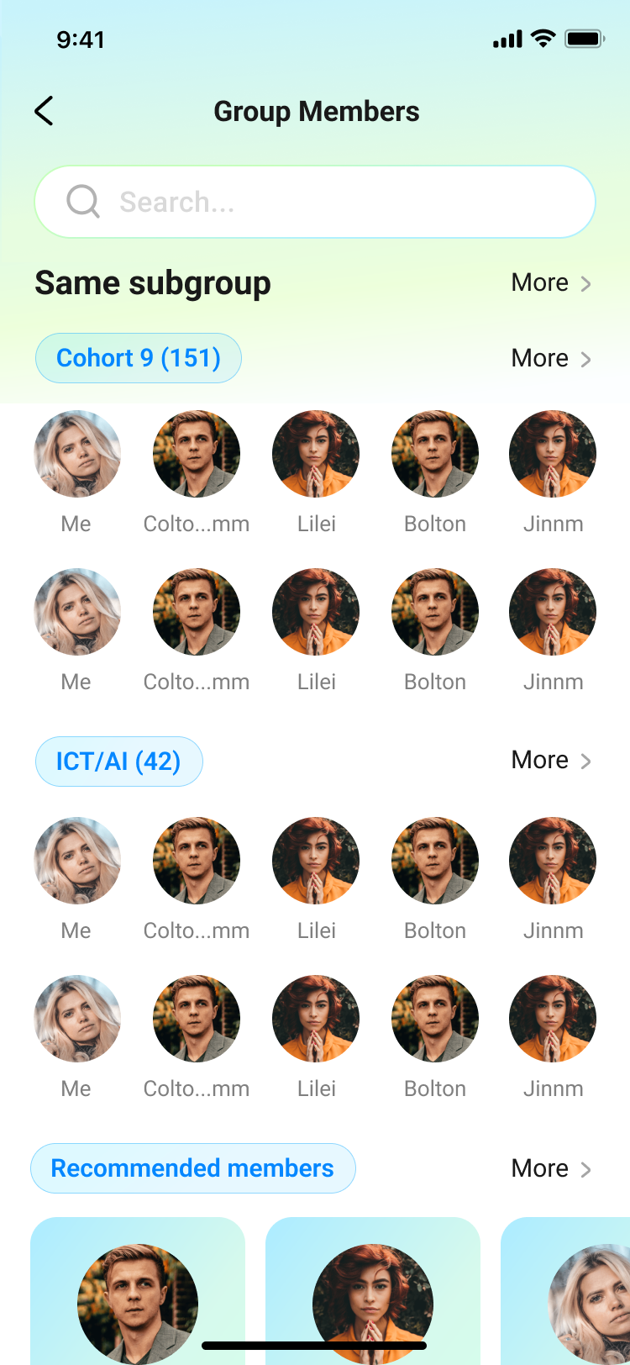
Advanced community management
Manage community members by subgroups.
This means that you can group your members based on different criteria such as interests, locations, age, or any other relevant factors. By doing so, you can easily communicate with specific subgroups, send targeted messages and announcements, and manage their activities more efficiently.
The app also allows you to organize community events and activities. You can create events and invite specific subgroups to participate, ensuring that everyone who is interested in the activity is informed. You can also track attendance and manage sign-ups through the app, making event management much easier.

Slide 9
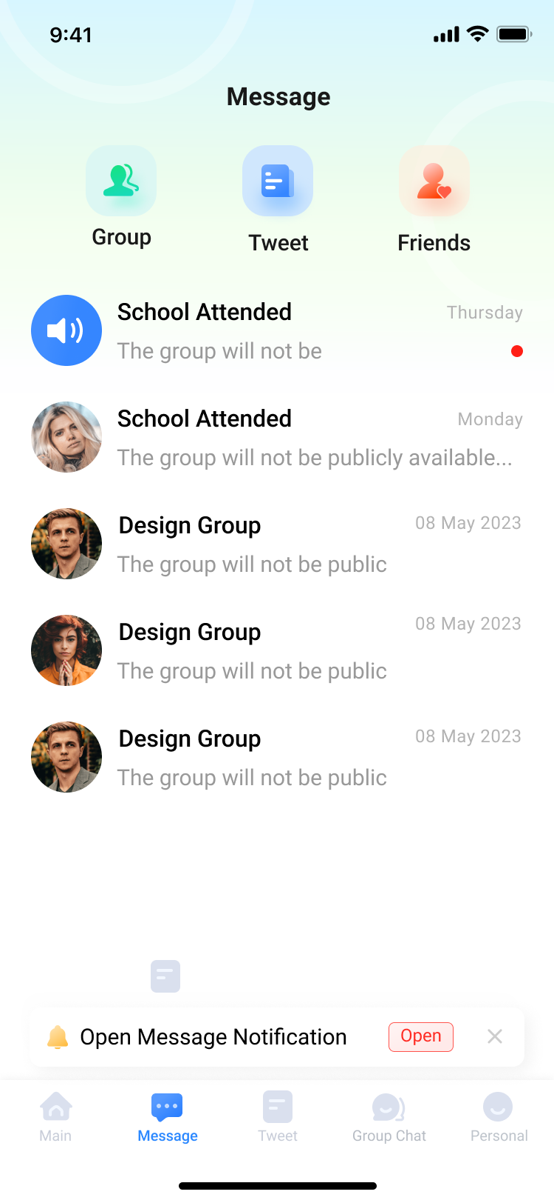
Advanced community management
Advanced messaging system that allows you to send your message to a specific group of people
The app features an advanced messaging system that allows you to communicate with other members of the communities you join. The messaging system offers a range of features that enable you to customize your messaging experience, control who can send and receive messages, and ensure that your messages are delivered to the right people.
One of the key features of the messaging system is the ability to assign permissions and subgroups to your messages. This means that you can choose who has access to your messages by specifying which subgroups or individuals can see them. For example, you could create a message that is only visible to members of a certain age group, or a message that is only visible to members who have a particular interest.

Slide 10
AI-based recommendation system

Slide 11
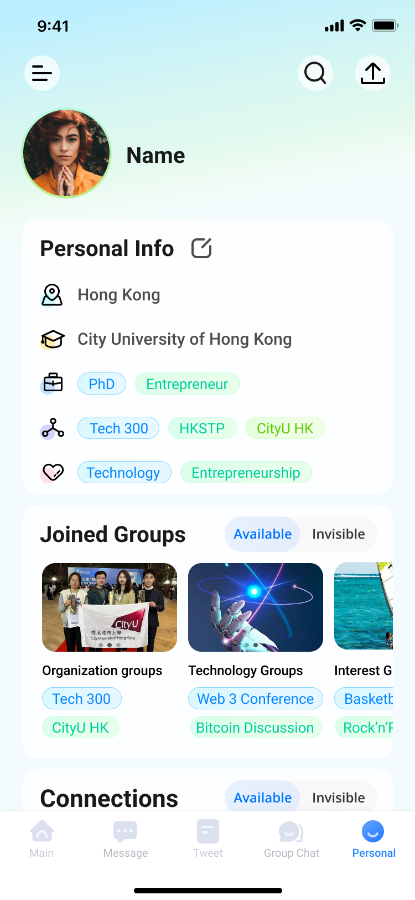
AI-based recommendation system
Create your profiles with specific tags that allows you to be recognized
By creating a profile with specific tags, you can establish your identity within the communities you join and connect with others who share similar interests. This can help you build deeper relationships with other members and foster a sense of community and belonging. The app's emphasis on real-name connections further reinforces this sense of community, encouraging users to build more authentic and meaningful connections with others.

Slide 12
AI-based recommendation system
Recommend highly-correlated groups or individuals to you according to your profile
The app features a recommendation system that suggests highly-correlated groups or individuals to you based on your profile. The recommendation system uses algorithms to analyze your profile information, such as your interests, hobbies, and location, and identifies other users or groups that share similar characteristics.

Slide 13
Use cases

Slide 14



AI-based recommendation system
Academic conferences

Slide 15


AI-based recommendation system
Organizations

Slide 16


AI-based recommendation system
Communities

